Slide 1

FINAL YEAR RESEARCH PROJECT
Review-1 Presentation
Automated Detection of Hardcoded Secrets in Modern Source Code Repositories using LLM-Augmented Static Analysis
Supervised By: Dr. Bhanu Pratap Rajak
Group No.: 03
Name of the Student(s) with Regd. No.:
Satyajeet Satapathy - 2241019340
Dinanath Dash - 2241004161
Avignyan Sarangi - 2241019304
Ashutosh Raj - 2241018015
Department of Computer Sc. and Engineering
Faculty of Engineering & Technology (ITER)
Siksha ‘O’ Anusandhan (Deemed to be) University
Bhubaneswar, Odisha
‹#›
Notes:
Good morning. I'm Dinanath, representing Group 3 alongside Satyajeet, Avignyan, and Ashutosh. Today, we are presenting our Review-1 progress on the automated detection of hardcoded secrets using LLM-augmented static analysis.

Slide 2
Presentation Outline
Problem Statement & Motivations
Problem Statement
Motivations
Literature Review
Existing Solutions & Limitations
Proposed Methodology & Approach
Key Components/Modules & Algorithms Used
Dataset & Tools/Technologies
Work Done So Far (Implementation Progress)
Preliminary Results (if any)
Future Work Plan
References
‹#›
Notes:
Our presentation will move rapidly from the problem of alert fatigue to our proposed hybrid architecture, followed by our current implementation results and the bottlenecks we are addressing.

Slide 3
Problem Statement
Domain: DevSecOps and Software Supply Chain Security.
Problem Statement:
Traditional static secret scanners lack semantic understanding, generating prohibitively high False Positive Rates by flagging safe test variables.
To resolve this, we engineered a two-stage hybrid scanning pipeline that uses Regex as a Stage-1 pre-filter and invokes a locally deployed, 4-bit quantized Meta Llama 3 model.
By analyzing a strict 11-line context window, our solution drastically reduces false alarms while maintaining total offline execution and data privacy.
‹#›
Notes:
In DevSecOps, traditional static secret scanners rely heavily on Regex and Entropy. The fatal flaw here is a lack of semantic understanding—they flag dummy credentials and safe test variables, creating massive False Positive Rates. This leads to severe alert fatigue for security teams. Our primary objective is to implement a two-stage hybrid scanning pipeline to slash these false positives without compromising our recall capabilities. Furthermore, we are committed to keeping this zero-trust by executing the LLM entirely offline.

Slide 4
Motivations
Motivation:
High FPR causes severe "Alert Fatigue" among security teams, delaying CI/CD pipelines and increasing the likelihood that genuine, critical vulnerabilities are overlooked in large-scale codebases.
Primary Objective:
To design and implement a two-stage hybrid scanning pipeline that drastically reduces False Positive Rates in secret detection without compromising recall capabilities.
Measurable Objectives:
To evaluate baseline Regex performance against the Hybrid LLM pipeline using a quantitative Confusion Matrix.
To achieve low-latency, zero-trust inference by executing a fine-tuned LLM entirely offline on local hardware.
‹#›
Notes:
In DevSecOps, traditional static secret scanners rely heavily on Regex and Entropy. The fatal flaw here is a lack of semantic understanding—they flag dummy credentials and safe test variables, creating massive False Positive Rates. This leads to severe alert fatigue for security teams. Our primary objective is to implement a two-stage hybrid scanning pipeline to slash these false positives without compromising our recall capabilities. Furthermore, we are committed to keeping this zero-trust by executing the LLM entirely offline.

Slide 5
Literature Review
Table1: Summary of Existing Approaches and Research Limitations
Author | Methods/ Techniques Used | Dataset Used | Research Outcomes | Findings & Limitations
Apostolidis et al. (2025) | CppCheck static analysis filtered by a fine-tuned CodeBERT vulnerability prediction model. | Big-Vul and ReVeal (C/C++ GitHub samples). | Reduced false positives, improving static analysis practicality with minimal impact on detection accuracy. | Vulnerability prediction models lack line-level granularity; static tools suffer from overwhelming false alarms.
Jin (2025) | Categorization of LLM adaptation into base application, static augmentation, RAG, fine-tuning, and hybrid fusion. | N/A (Survey paper analyzing standardized benchmarks). | Identified optimal architectural strengths (encoder vs. decoder) for different security priorities. | High token consumption, context window limits, and poor generalization remain major barriers.
Dozono et al. (2025) | Empirical evaluation of 5 frontier LLMs comparing open-source vs. closed-source code performance. | CWE-Bench-Java (Open) and TS-Vuls (Closed, commercial Teamscale codebase). | Precision dropped significantly from 56% on open-source code to 34% on closed-source code. | LLM metrics are heavily inflated on open-source data due to training contamination.
Guo et al. (2023) | Systematic review of 130 false positive mitigation studies across 5 technical categories. | N/A (Literature Review). | Established a taxonomy for false positive mitigation and identified deep learning and NLP as future directions. | Current approaches suffer from low explainability, ambiguous concept definitions, and dataset biases.
‹#›
Notes:
We analyzed current literature and existing solutions to establish our baseline. The consensus is that while LLMs improve accuracy, they introduce new, restrictive barriers in real-world application.

Slide 6
Literature Review contd.
Table2: Summary of Existing Approaches and Research Limitations, contd.
Author | Methods/ Techniques Used | Dataset Used | Research Outcomes | Findings & Limitations
Li et al. (2025) | Injecting vulnerability steering vectors into LLM activation layers without altering original parameters. | SARD, FFmpeg+Qemu, Reveal, REEF. | Outperformed state-of-the-art methods with a 12.86% F1-score increase on real-world datasets. | Existing representation methods focus on overall semantics instead of isolating specific vulnerability concepts.
Muske & Khedker (2015) | Data flow analysis computing Complete-range Non-deterministic Value (cnv) variables. | Embedded C system applications (SCMS, BCM). | Cut redundant model checking calls by 49.49% and reduced false positive elimination time by 39.28%. | Speed gains were achieved at the cost of missing 2.78% of false positives due to execution path over-approximation.
Kim et al. (2025) | Reinforcement learning (RL) based context generator to infer contextual signals from user prompts. | SafetyInstruct, Advbench, Wildjailbreak, XSTest. | Reduces harmful responses while preventing unnecessary refusals of benign requests. | Conventional LLM frameworks fail on ambiguous tasks; extracting context is necessary to prevent bypassing safeguards.
Schwarz (2025) | "Countermind" multi-layered security architecture using Semantic Boundary Logic (SBL) and Parameter-Space Restriction (PSR). | N/A (Conceptual/Architectural design). | Shifts LLM defenses from reactive post-hoc filtering to proactive pre-inference structural validation. | Post-hoc filters are brittle against prompt injections; models inherently struggle to distinguish trusted instructions from untrusted data.
‹#›
Notes:
We analyzed current literature and existing solutions to establish our baseline. The consensus is that while LLMs improve accuracy, they introduce new, restrictive barriers in real-world application.

Slide 7
Research Gap & Improvements
Identified Limitation 1: Token Inefficiency & Latency Bottlenecks
Recent surveys (e.g., Jin, 2025) highlight that analyzing entire repositories using LLMs results in severe token consumption and context window exhaustion.
Our Improvement: We utilize a "cascading filter" approach. By using deterministic Regex as a Stage-1 pre-filter, we only invoke the LLM on a strict 11-line context window, bypassing the latency constraints of pure-LLM scanners.
Identified Limitation 2: Granularity and "Context Blindness"
Existing vulnerability models often evaluate overall file semantics rather than isolating specific vulnerability concepts (Li et al., 2025), and lack line-level granularity (Apostolidis et al., 2025).
‹#›
Notes:
We identified three major limitations in current research: token inefficiency, context blindness, and data privacy. Sending raw source code to external APIs like OpenAI violates zero-trust models. To solve this, we use a cascading filter. We use Regex as a Stage-1 pre-filter, and only send a strict 11-line Abstract Syntax Tree context to the LLM. To guarantee data privacy, we deploy a 4-bit quantized Llama 3 8B model locally using the Apple MLX framework.

Slide 8
Research Gap & Improvements contd.
Our Improvement: We extract the Abstract Syntax Tree (AST) context (5 lines above and below the Regex match). Our LoRA fine-tuning specifically trains the model to evaluate variable scope and dummy test parameters within this micro-context.
Identified Limitation 3: The Data Privacy Paradigm
State-of-the-art LLM security tools rely on cloud-based APIs. Sending proprietary, unredacted corporate source code to external servers (OpenAI/Anthropic) violates Zero-Trust security models and data compliance laws.
Our Improvement: Total offline execution. We bridge this gap by deploying a 4-bit quantized Meta Llama 3 8B model locally using the Apple MLX framework, leveraging Unified Memory for secure, on-device inference.
‹#›
Notes:
We identified three major limitations in current research: token inefficiency, context blindness, and data privacy. Sending raw source code to external APIs like OpenAI violates zero-trust models. To solve this, we use a cascading filter. We use Regex as a Stage-1 pre-filter, and only send a strict 11-line Abstract Syntax Tree context to the LLM. To guarantee data privacy, we deploy a 4-bit quantized Llama 3 8B model locally using the Apple MLX framework.

Slide 9
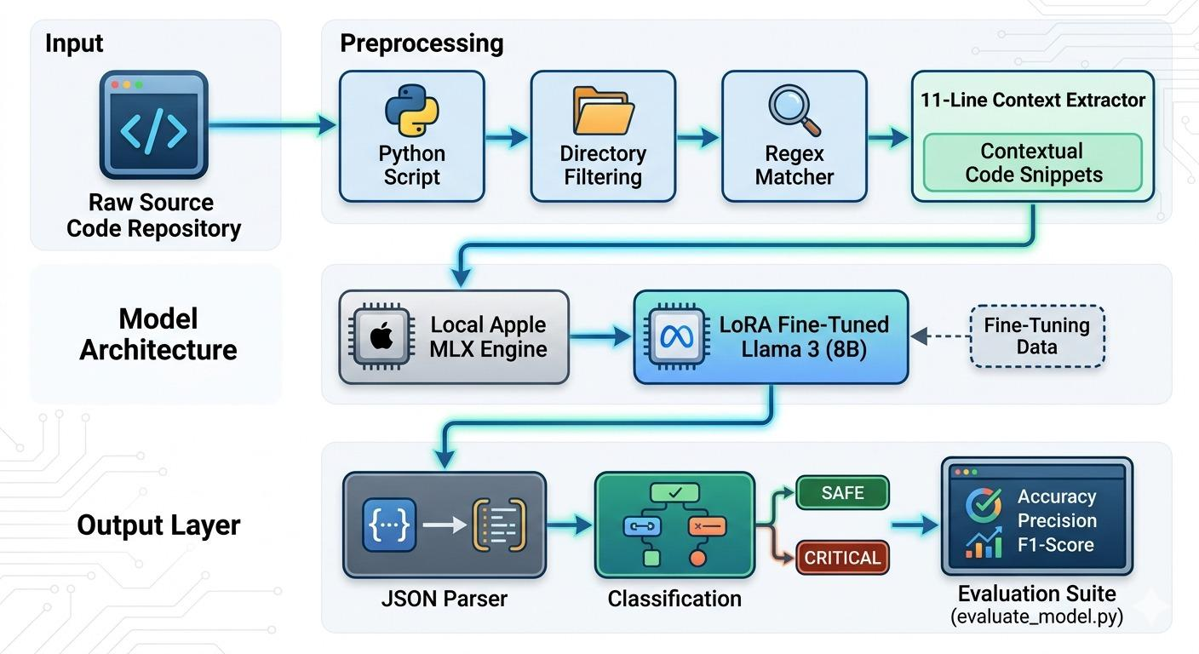
Proposed Solution & Architecture
Fig. 1: Schematic Model Diagram of the Proposed Model
‹#›
Notes:
Here is the schematic of our model. We are evaluating this architecture against the open-source CredData benchmark, which contains roughly 27,000 lines of real-world code. Everything is orchestrated in Python and runs locally on Apple Silicon utilizing Unified Memory.

Slide 10
Dataset & Tools/Technologies
Dataset Description:
Source: The open-source CredData benchmark dataset.
Composition: Comprises approximately 27,000 lines of real-world source code snippets utilized to evaluate the detection of hardcoded credentials.
Tools & Technologies:
Language & Orchestration: Python 3.10+
AI Model: Meta Llama 3 8B Instruct (4-bit quantized).
Compute Framework: Apple MLX Framework.
Hardware: Local execution on Apple Silicon (M-series Mac) utilizing Unified Memory for offline inference.
‹#›
Notes:
Here is the schematic of our model. We are evaluating this architecture against the open-source CredData benchmark, which contains roughly 27,000 lines of real-world code. Everything is orchestrated in Python and runs locally on Apple Silicon utilizing Unified Memory.

Slide 11
Progress in Implementation
Literature & Dataset Prep: Comprehensive analysis of recent (2023-2026) LLM vulnerability methodologies is complete. The CredData benchmark (approx. 27,000 lines) is fully integrated into the local environment.
Pipeline Implementation:
Phase 1 (Regex + 11-line AST context extraction) and Phase 2 (Apple MLX inference) are fully operational.
Model fine-tuning (LoRA at 3000 iterations) successfully stabilized strict JSON output parsing.
Testing Scale-Up: Transitioned from randomized micro-subsets to full-scale empirical benchmarking against the entire CredData dataset.
‹#›
Notes:
Regarding our progress, Phase 1—the Regex and AST context extraction—and Phase 2—the local MLX inference—are fully operational. We have successfully fine-tuned the model using LoRA at 3000 iterations to enforce strict JSON output parsing, and we have scaled our testing to the full CredData dataset.

Slide 12
CredData Benchmark Results
Experimental Setup: Conducted a head-to-head comparative analysis on the CredData dataset against industry-standard offline scanners (TruffleHog and Gitleaks).
The Baseline Failure (Context Blindness):
TruffleHog failed entirely (Precision: 0.4301, Recall: 0.0123).
Gitleaks (Regex) maintained high Precision (0.8600) but suffered catastrophic False Negatives, missing 74% of actual secrets (Recall: 0.2600).
Hybrid Model Performance:
Overall Accuracy: Achieved 87.0%, demonstrating stable and reliable classification across a standardized 1,000-hit evaluation subset.
Achieved a dominant F1-Score of 0.8723 within the test sample.
Precision remained highly competitive at 0.8117, while Recall surged to 0.9427.
The Latency Reality: Executing this 1k subset took approximately 3.5 hours via local Apple MLX inference. This validates our semantic detection hypothesis but strictly defines our next engineering phase: scaling inference speed to handle full-corpus repository scans.
‹#›
Notes:
The baseline results expose the 'context blindness' of traditional tools. In our tests, TruffleHog failed entirely with a 0.0123 recall, while Gitleaks missed 74% of actual secrets. In contrast, our hybrid model achieved an 87% overall accuracy. We maintained a highly competitive Precision of 0.8117 while surging our Recall to 0.9427. The F1-Score sits at a dominant 0.8723.

Slide 13
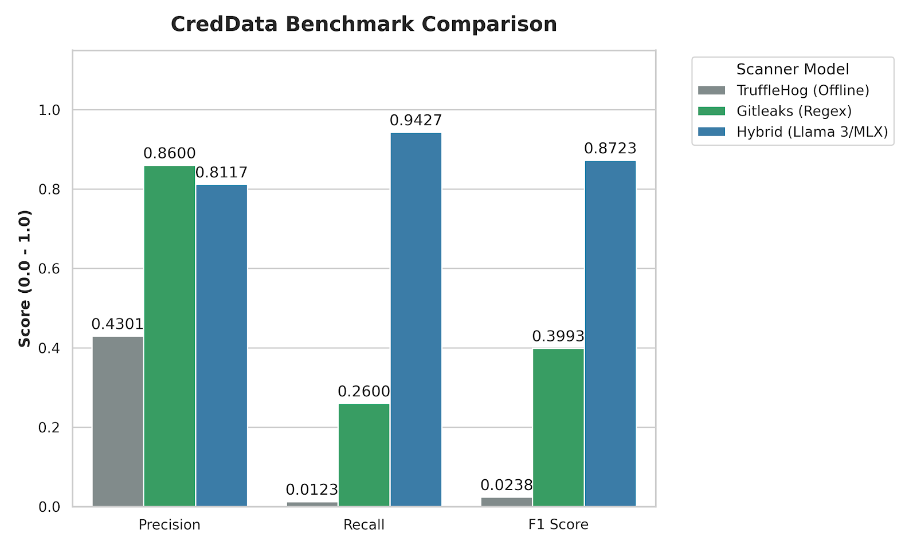
CredData Benchmark Results contd.
Fig. 2: Precision, Recall, and F1-Score evaluation of the Hybrid Llama 3/MLX architecture against industry baselines.
‹#›
Notes:
The baseline results expose the 'context blindness' of traditional tools. In our tests, TruffleHog failed entirely with a 0.0123 recall, while Gitleaks missed 74% of actual secrets. In contrast, our hybrid model achieved an 87% overall accuracy. We maintained a highly competitive Precision of 0.8117 while surging our Recall to 0.9427. The F1-Score sits at a dominant 0.8723.

Slide 14
Current Challenges & Latency Bottlenecks
The Latency Reality: While the Apple MLX framework ensures Zero-Trust privacy via local execution, running a quantized 8B parameter model is fundamentally slower than pure C-based Regex.
Pipeline Blocking: Executing sequential LLM inference on hundreds of initial Regex matches currently creates a severe bottleneck, making it impractical for monolithic repository scans in a fast-paced CI/CD environment.
Prompt Engineering Impact: Implementing a strict Few-Shot Prompting template halved the initial context processing time and stabilized outputs, but the baseline per-snippet inference speed remains a critical hurdle for production deployment.
‹#›
Notes:
However, we must address the operational reality: executing this 1,000-hit subset took 3.5 hours locally. Sequential LLM inference is currently a severe bottleneck that makes monolithic repository scans impractical for fast-paced CI/CD pipelines. Moving forward, our priority shifts aggressively from detection accuracy to operational speed. We will investigate batch processing and model pruning to bring inference times down to viable thresholds, and we will validate our generalization against the FPSecretBench dataset before packaging this as a deployable GitHub Action.

Slide 15
Future Work Plan
Cross-Dataset Validation: The model’s current performance is heavily biased toward the CredData benchmark. We will validate generalization by testing against the FPSecretBench dataset, pending access approval from the authors.
Aggressive Latency Mitigation: Shift research focus from detection accuracy to operational speed. Investigate batch processing through the MLX engine or aggressive model pruning to drop per-snippet inference times to a viable DevSecOps threshold.
Pipeline Integration: Package the validated Python/MLX architecture into a deployable CLI tool or a standardized GitHub Action for seamless CI/CD pipeline integration.
‹#›
Notes:
However, we must address the operational reality: executing this 1,000-hit subset took 3.5 hours locally. Sequential LLM inference is currently a severe bottleneck that makes monolithic repository scans impractical for fast-paced CI/CD pipelines. Moving forward, our priority shifts aggressively from detection accuracy to operational speed. We will investigate batch processing and model pruning to bring inference times down to viable thresholds, and we will validate our generalization against the FPSecretBench dataset before packaging this as a deployable GitHub Action.

Slide 16
References
[1] G. D. Apostolidis, I. Kalouptsoglou, M. Siavvas, D. Kehagias, and D. Tzovaras, "AI-Enhanced Static Analysis: Reducing False Alarms Using Large Language Models," in 2025 IEEE International Conference on Smart Computing (SMARTCOMP), 2025.
[2] S. Jin, "Large Language Models for Vulnerability Detection in Static Code Analysis: A Survey," in 2025 8th International Conference on Artificial Intelligence and Big Data (ICAIBD), 2025.
[3] K. Dozono, J. Engesser, B. Hummelt, T. Roehm, and A. Pretschner, "Should We Evaluate LLM Based Security Analysis Approaches on Open Source Systems?," in 2025 40th IEEE/ACM International Conference on Automated Software Engineering (ASE), 2025.
[4] Z. Guo et al., "Mitigating False Positive Static Analysis Warnings: Progress, Challenges, and Opportunities," IEEE Transactions on Software Engineering, vol. 49, no. 12, pp. 5154-5186, Dec. 2023.
[5] J. Li et al., "Steering Large Language Models for Vulnerability Detection," in 2025 IEEE International Conference on Acoustics, Speech and Signal Processing (ICASSP), 2025.
[6] T. Muske and U. P. Khedker, "Efficient Elimination of False Positives using Static Analysis," in 2015 IEEE, 2015.
[7] M. Kim, L. Caccia, Z. Shi, M. Pereira, M.-A. Côté, X. Yuan, and A. Sordoni, "Learning to Extract Context for Context-Aware LLM Inference," Microsoft Research, 2025.
[8] D. Schwarz, "Countermind: A Multi-Layered Security Architecture for Large Language Models," arXiv preprint arXiv:2510.11837v1, Oct. 2025.
Notes:
These are the references that ground our methodology. Thank you everyone, we are now open to your questions.

Slide 17

‹#›
Notes:
These are the references that ground our methodology. Thank you everyone, we are now open to your questions.

